Slide 1
COVID-19 ----- California
Crystal, Yi. Lucy, Sun. Rase, Wang. Ryan, Chen.
Notes:
https://www.ksnblocal4.com/content/news/Update-on-two-Hall-County-COVID-19-cases-569161701.html
https://www.livescience.com/california-coronavirus-updates.html

Slide 2
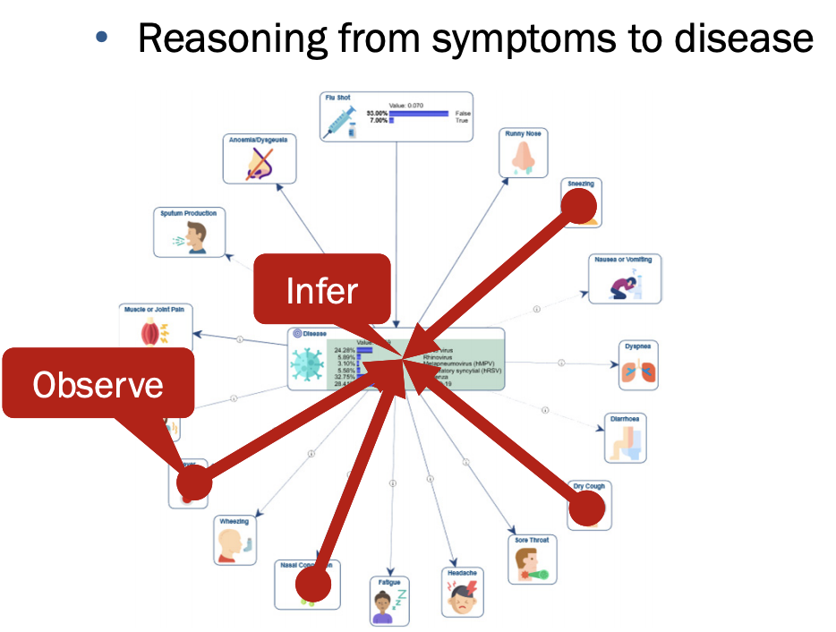
COVID-19 Symptoms Analysis (BayesiaLab)
By observing existing diagnosis syndrome to predict the possibilities of getting COVID-19
List related symptoms
Set possibility for each symptoms
Simulate on BayesiaLab
Analyze the result
Notes:
症状分析

Slide 3
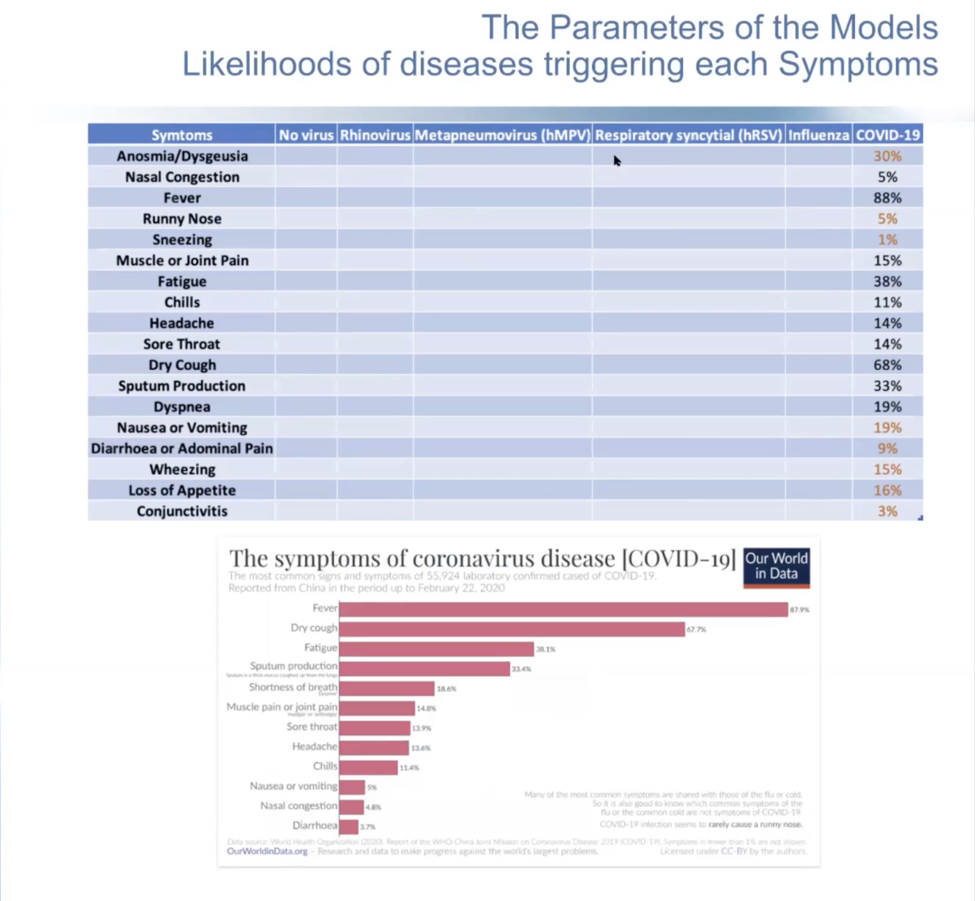
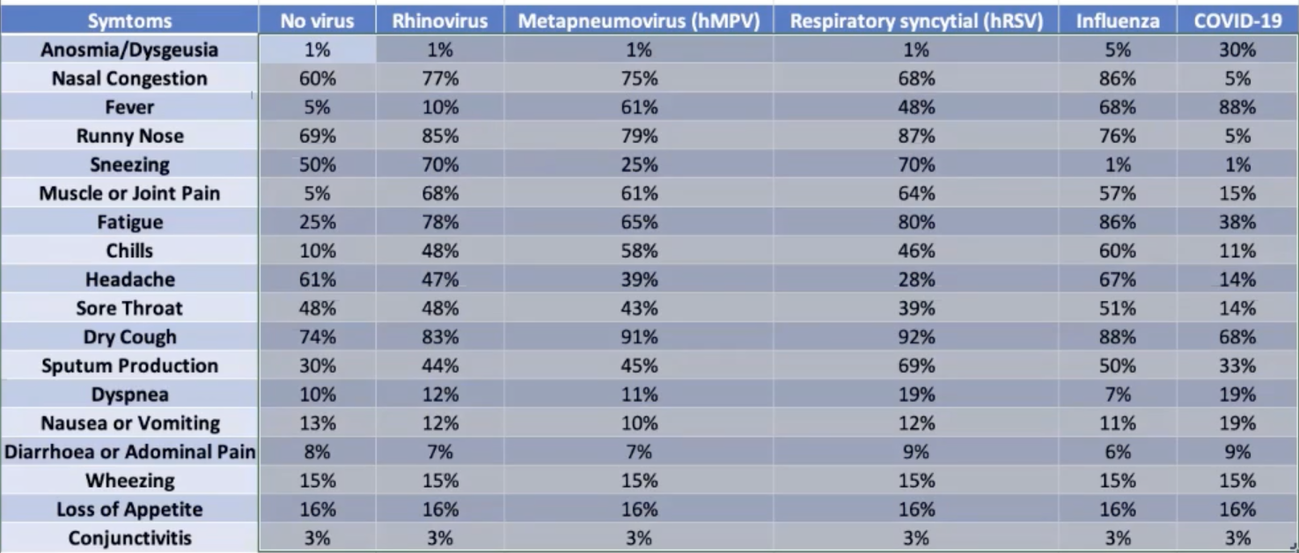
List syndromes and related diagnosis
Notes:
临床反应对应病毒比率表

Slide 4
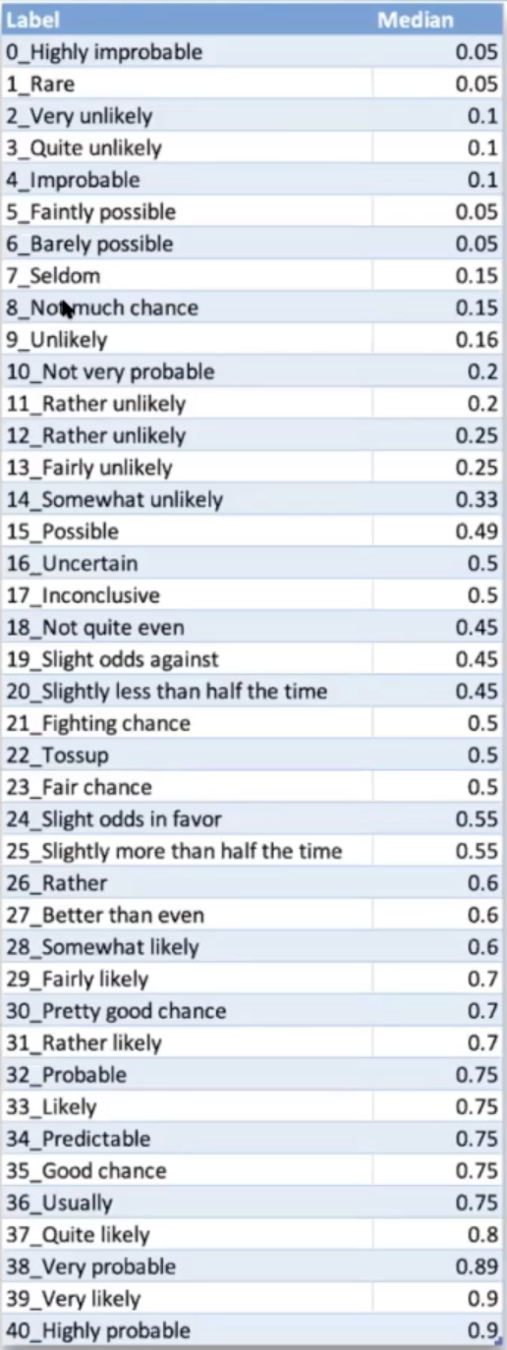

Slide 5
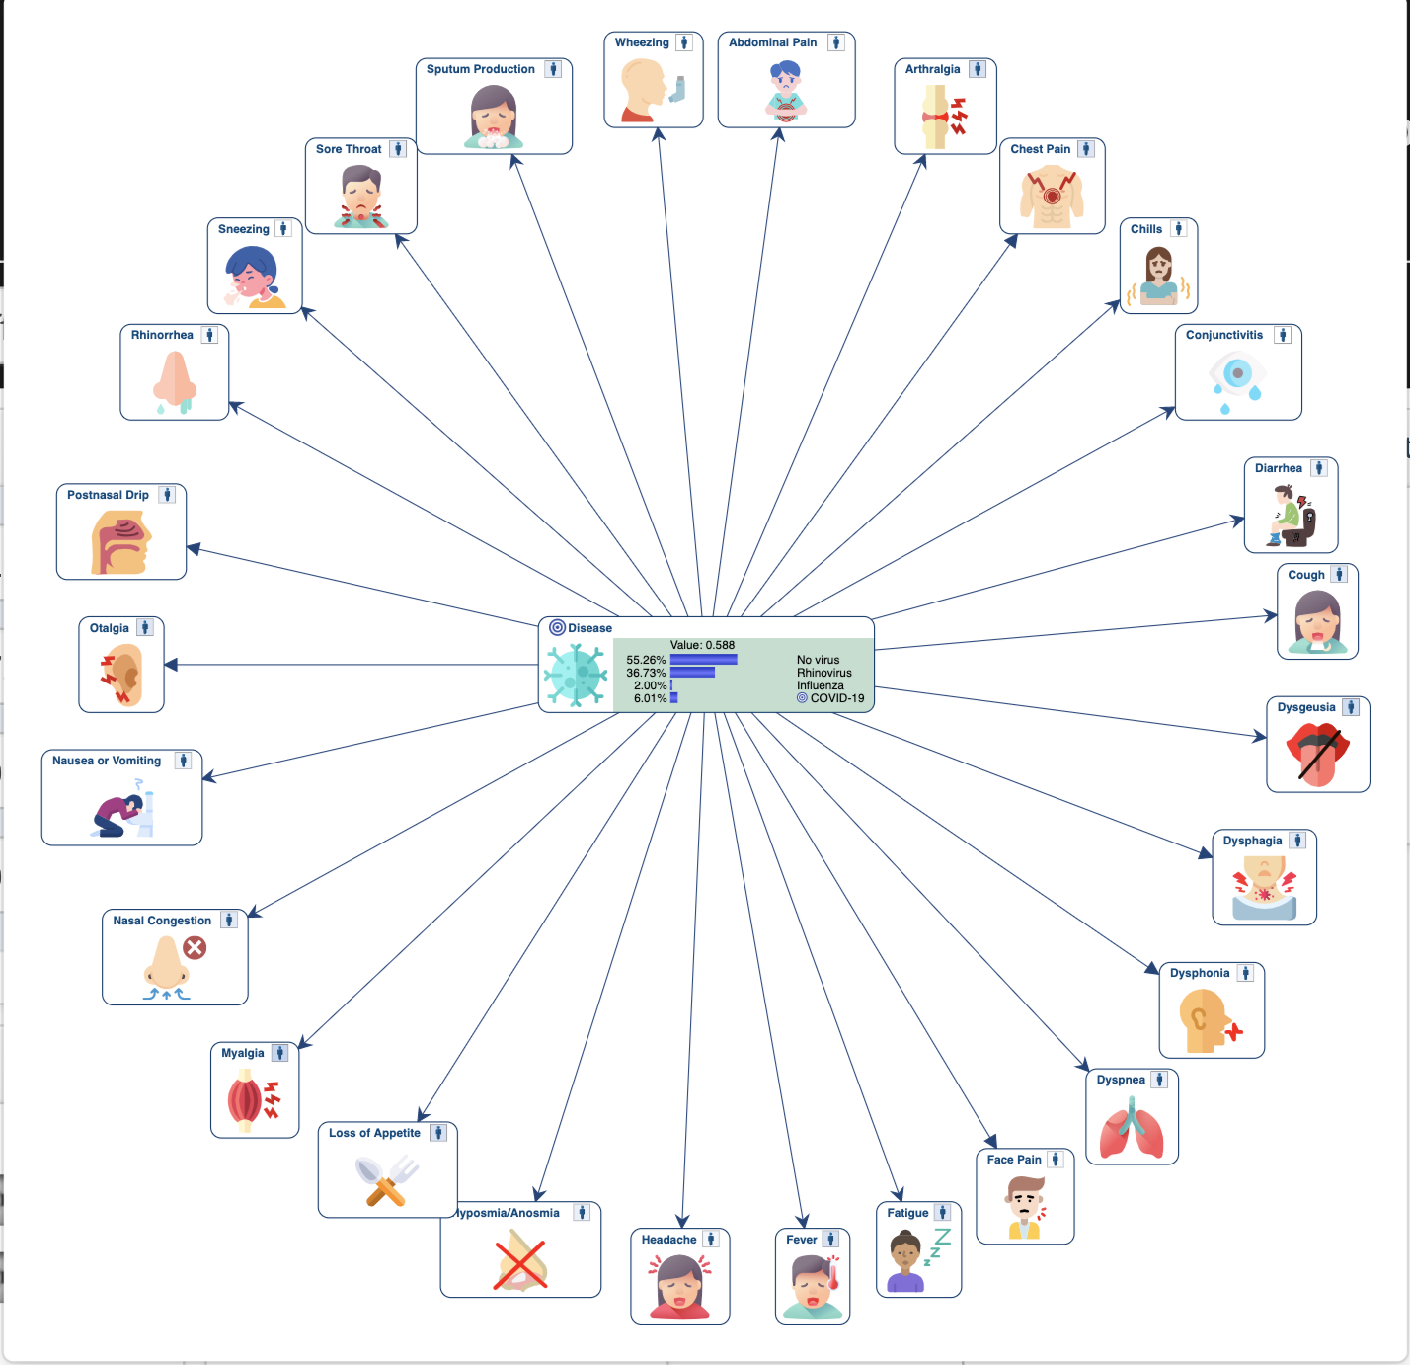
Notes:
疑似症状

Slide 6
Notes:
疑似症状

Slide 7
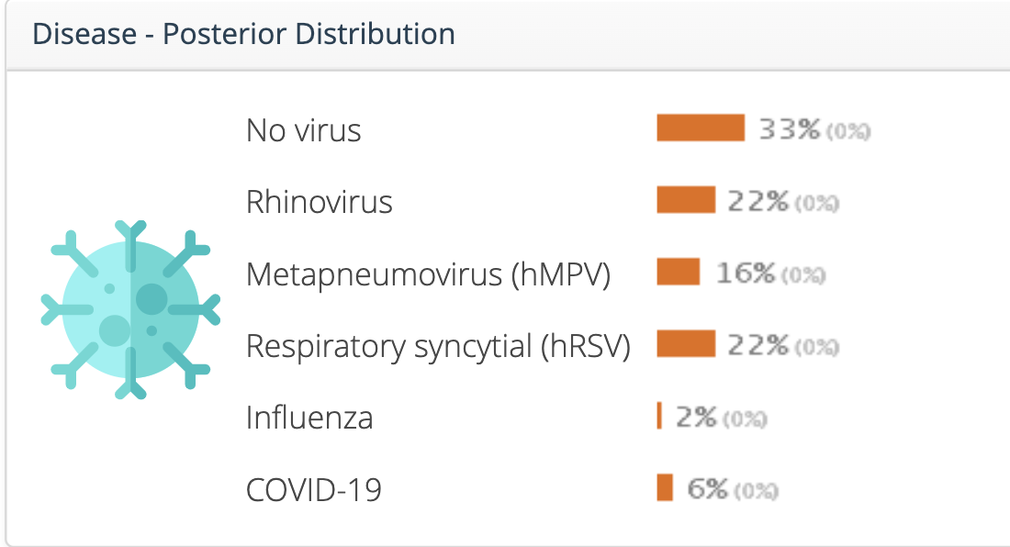
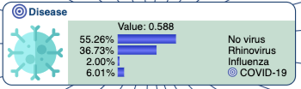
Notes:
病毒百分比

Slide 8
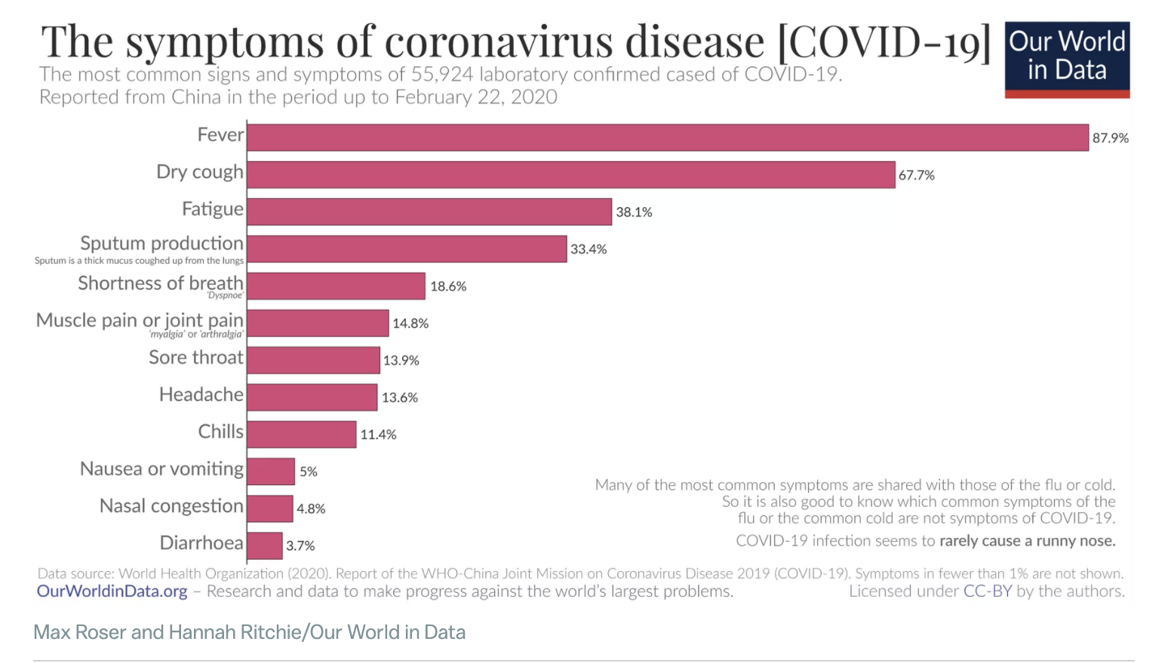
Notes:
症状统计图

Slide 9
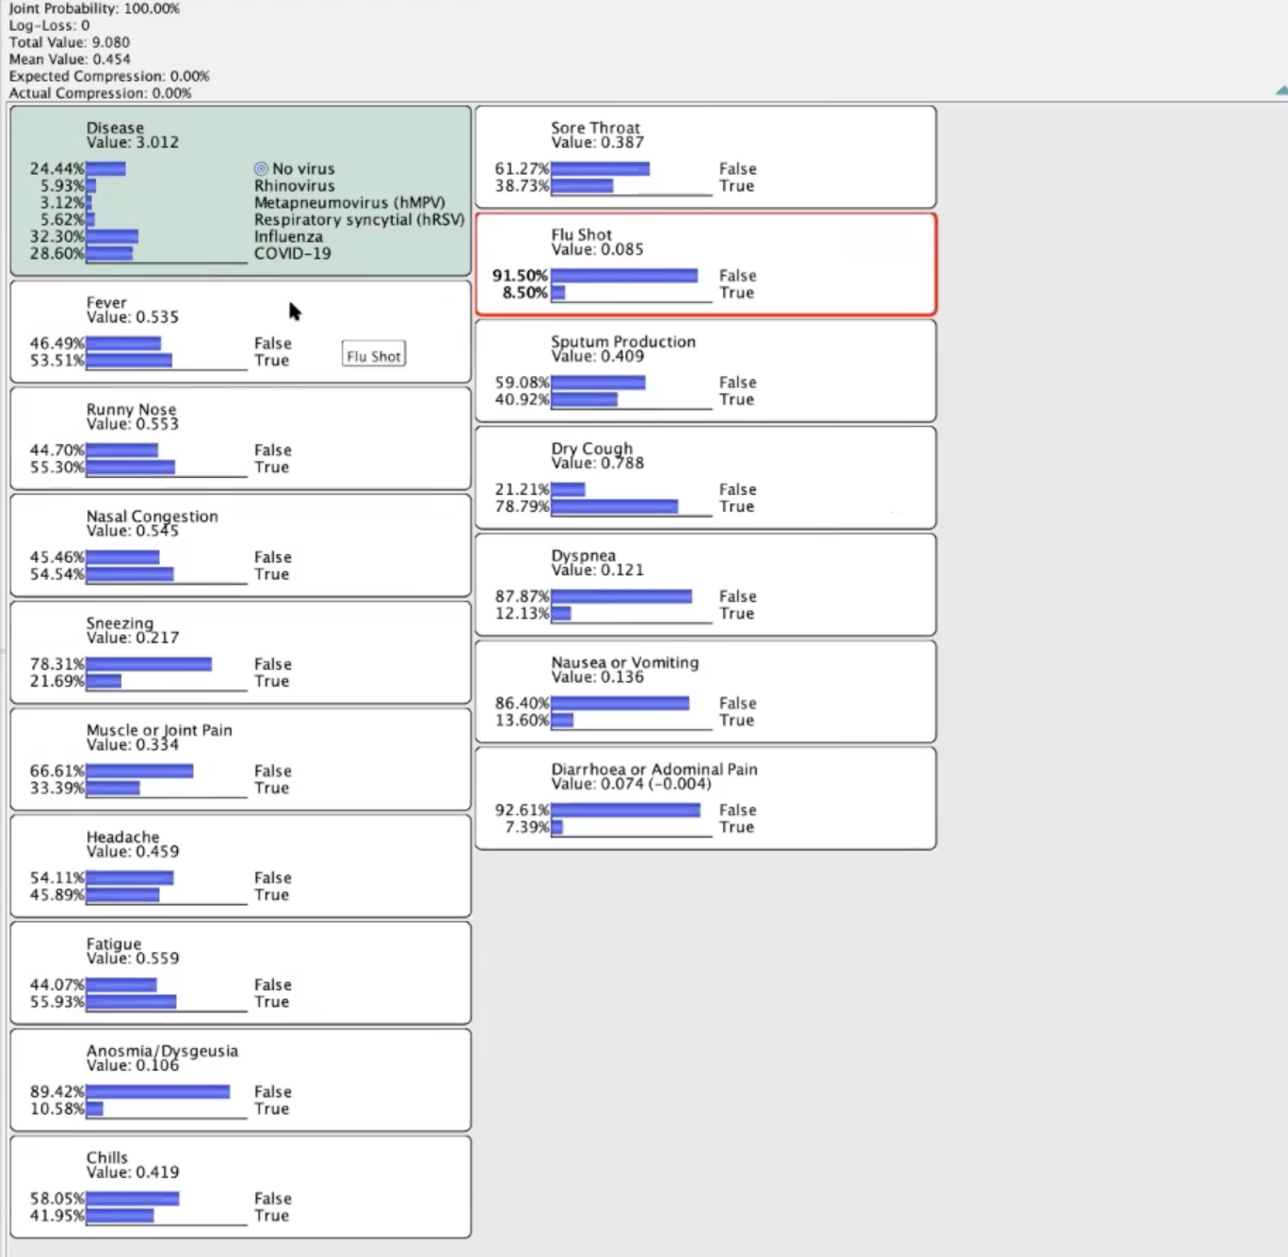
Notes:
确诊临床反应概率

Slide 10
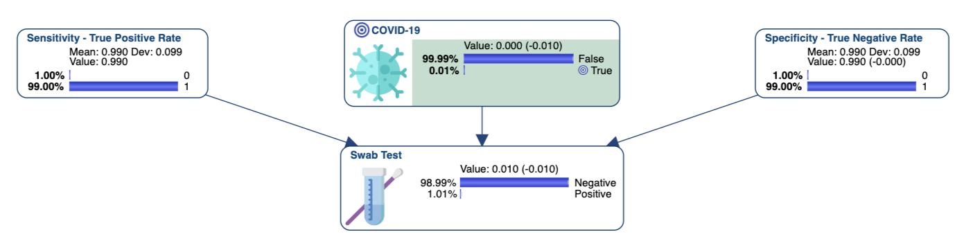
Notes:
阴性各项指标

Slide 11
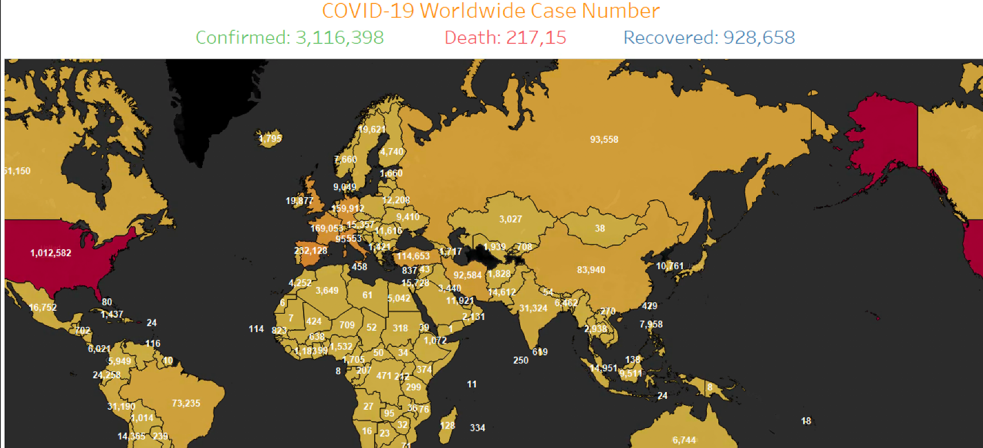
Notes:
世界总确诊，死亡，治愈人数。

Slide 12
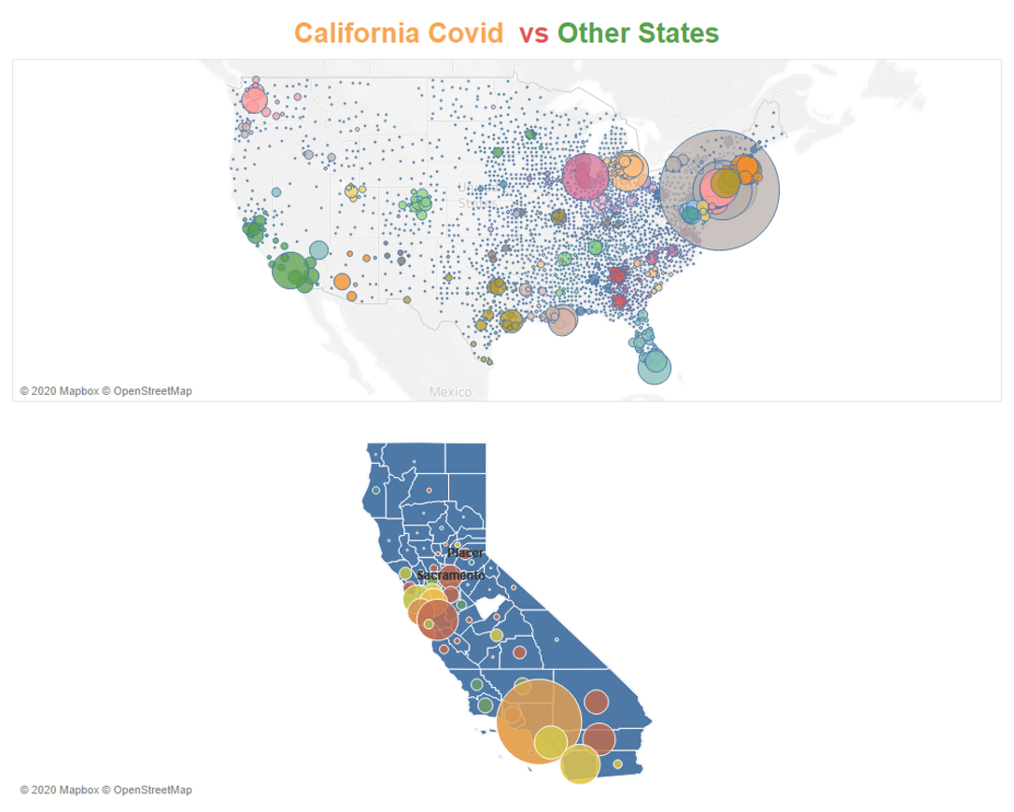
California Total COVID-19 Confirmed Case: 50442
Notes:
加州确诊人数分布.

Slide 13
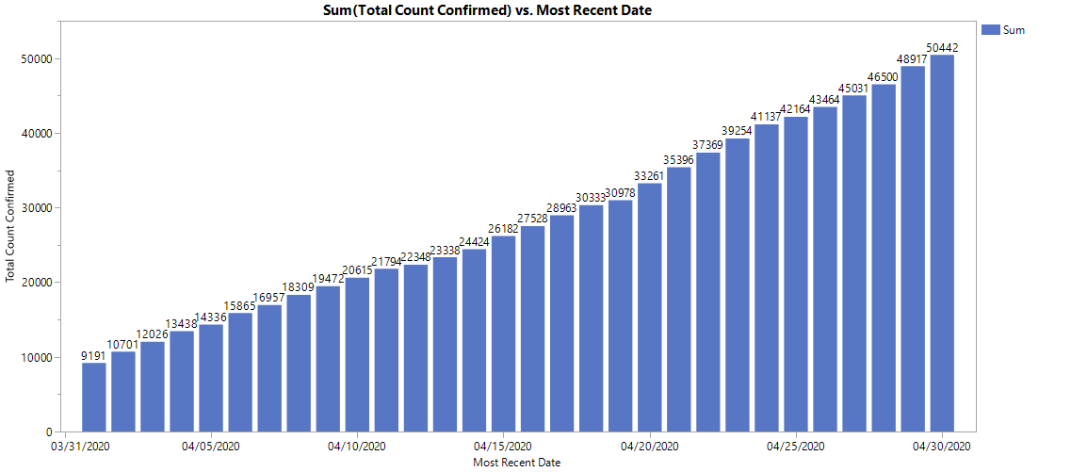
Total Count of Case Confirmed From 3/31 to 4/30

Slide 14
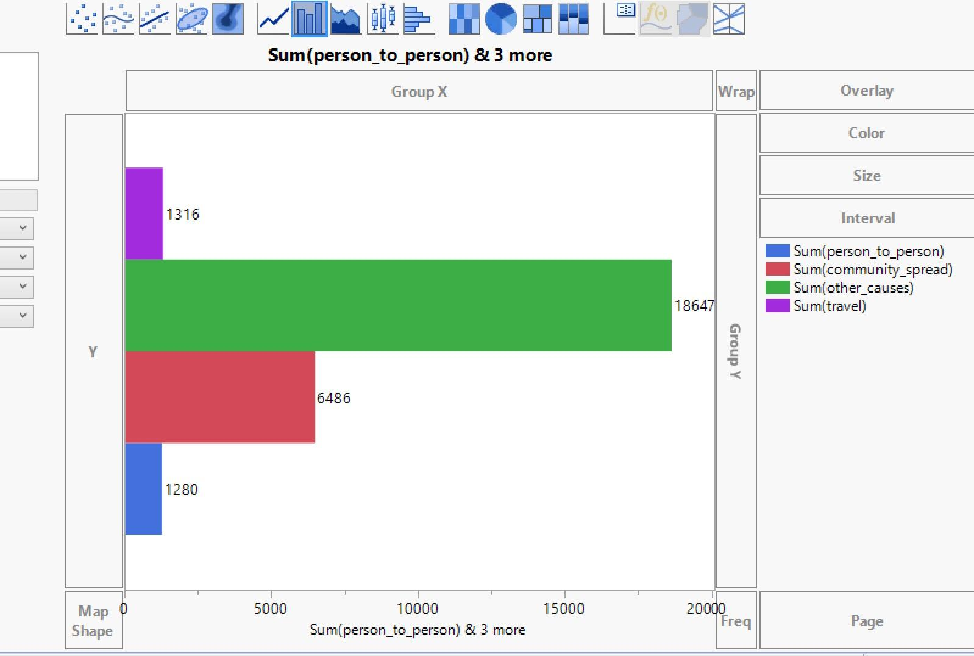

Slide 15
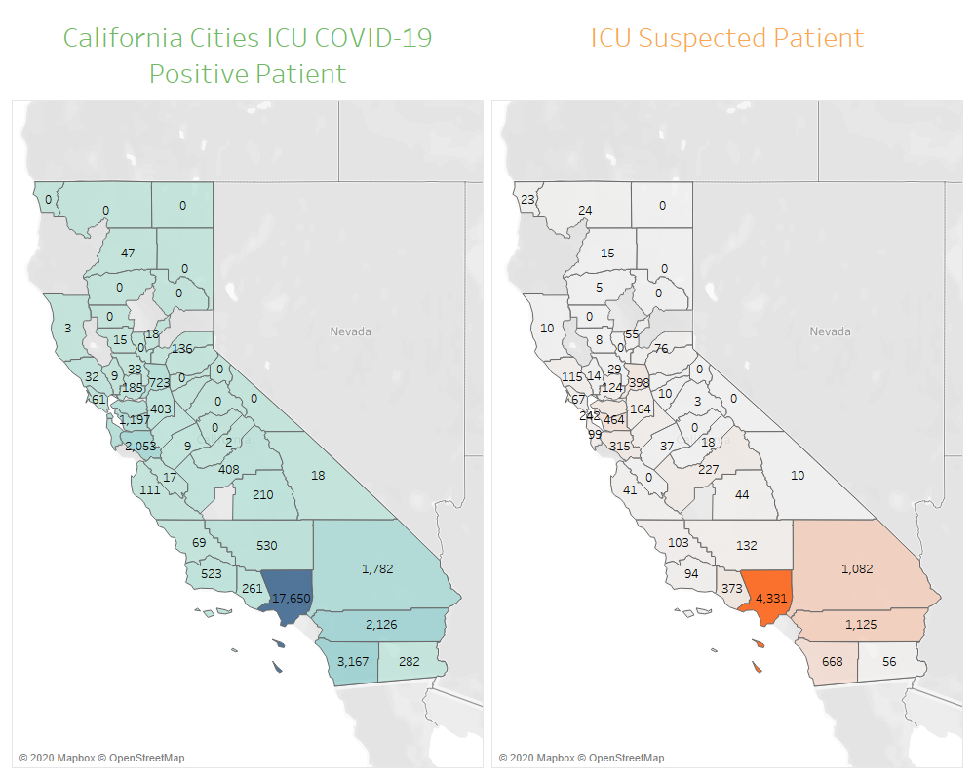
Notes:
加州阳性确诊人数分布图
加州疑似病例分布图

Slide 16
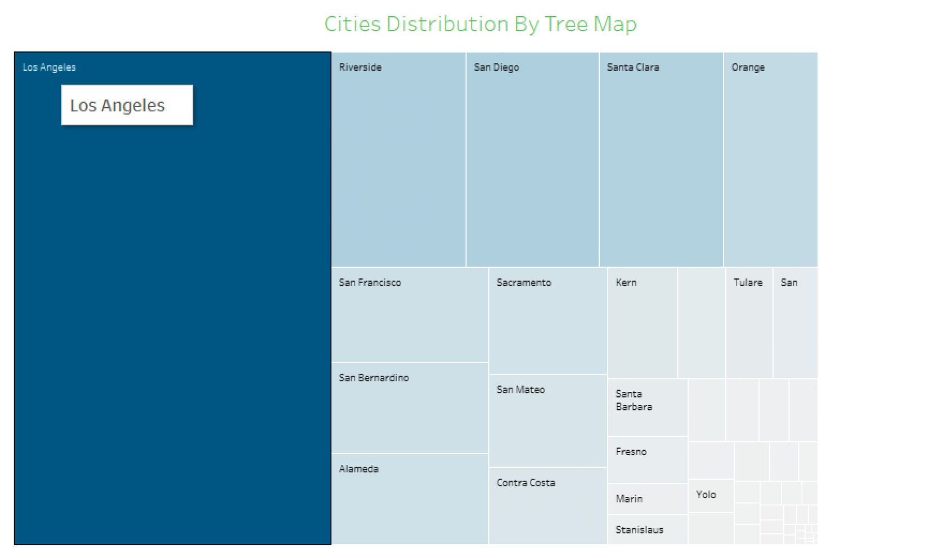
Notes:
加州城市确诊树图

Slide 17
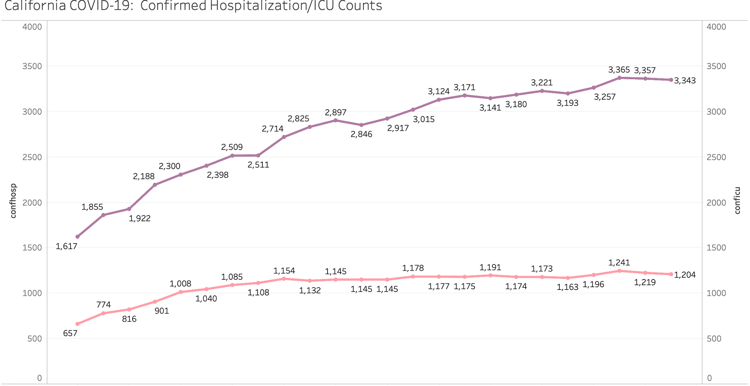
Notes:
医护人员确诊病例趋势图

Slide 18
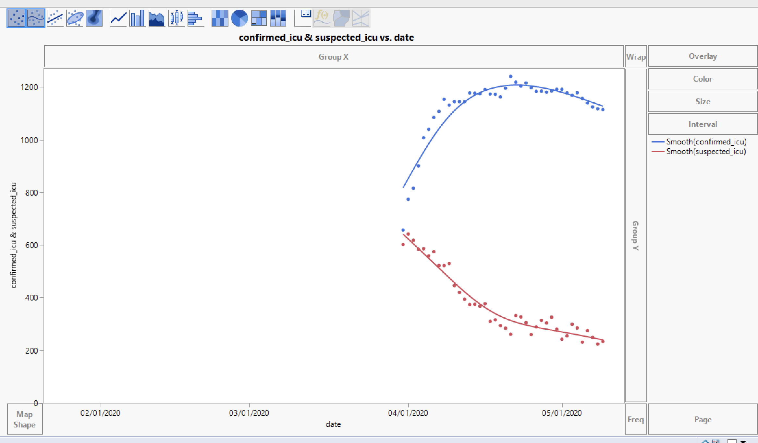

Slide 19
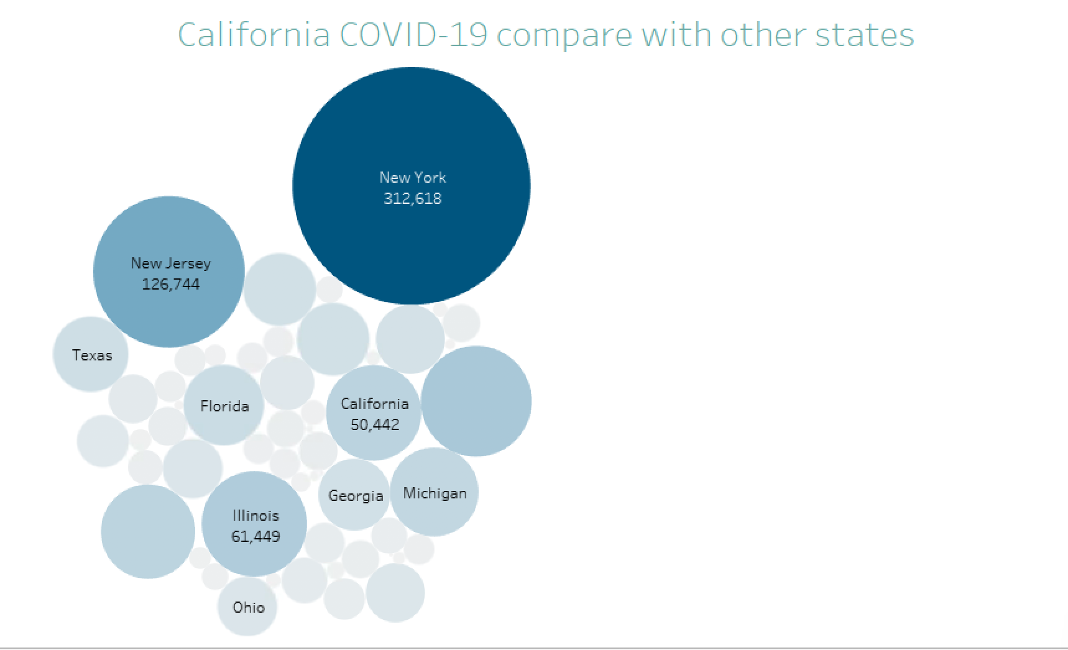
Notes:
加州确诊人数与其他州对比

Slide 20
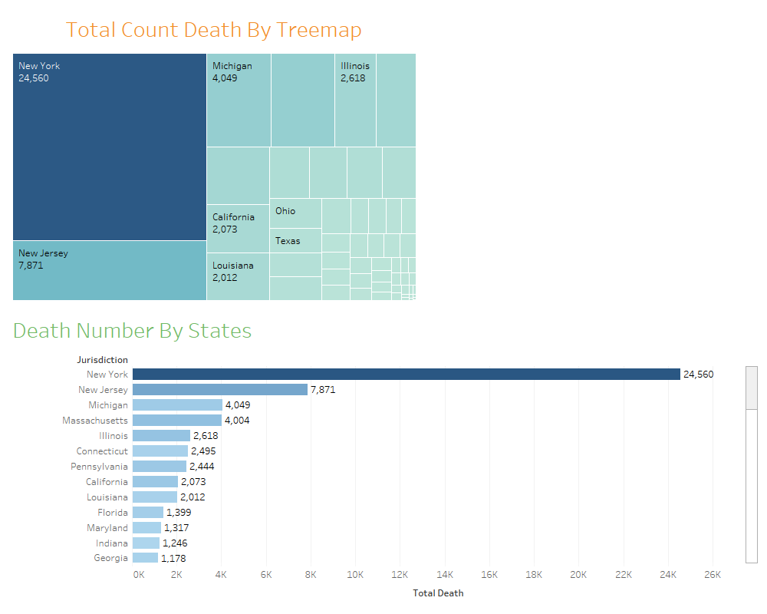
Notes:
美国死亡人数树图
各州死亡人数统计图
].

Slide 21
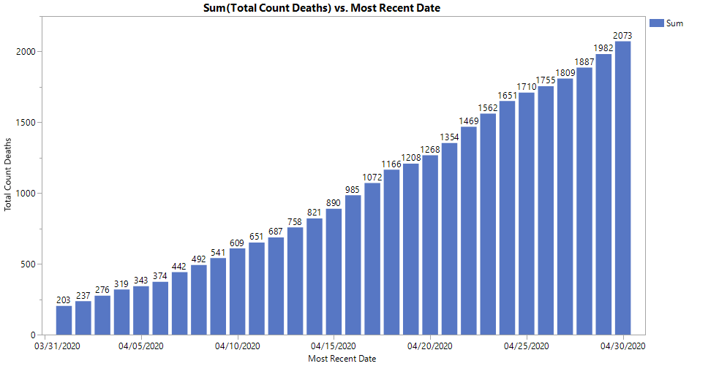
Total Count Death From 3/31 to 4/30

Slide 22
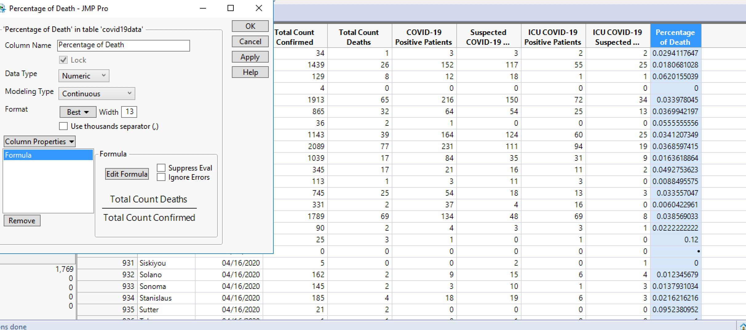

Slide 23
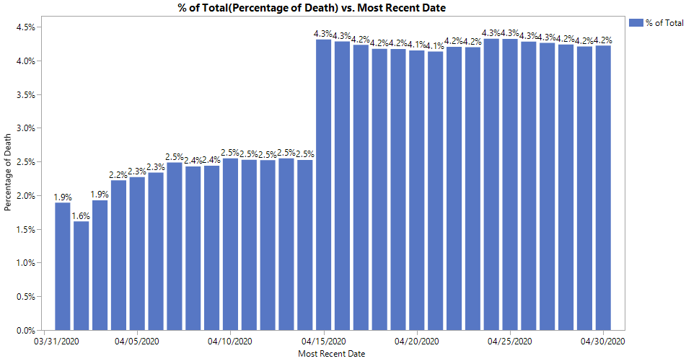
Percentage of Death
Notes:
死亡比率趋势图

Slide 24
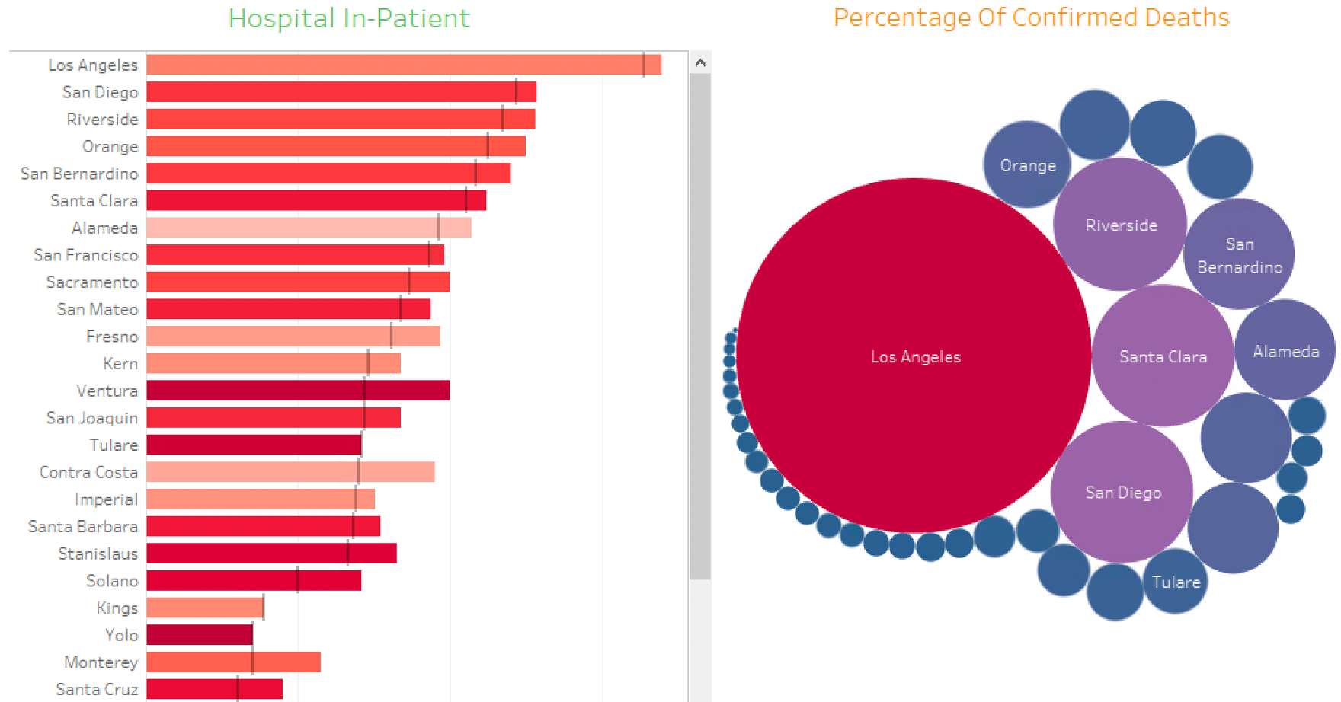
Notes:
加州城市住院病例统计图
城市死亡图对比

Slide 25
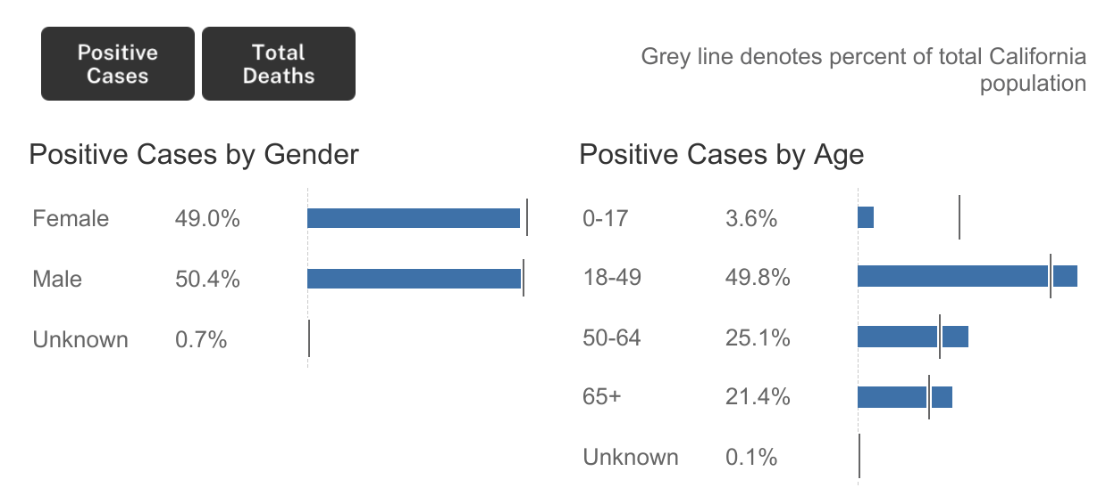

Slide 26
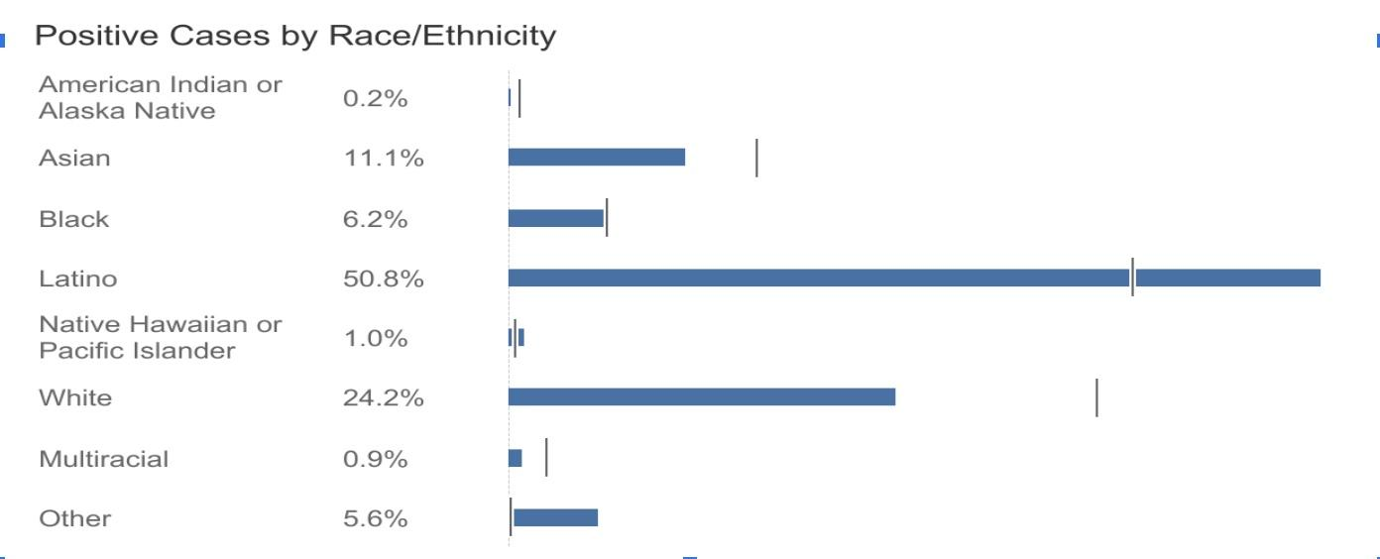

Slide 27
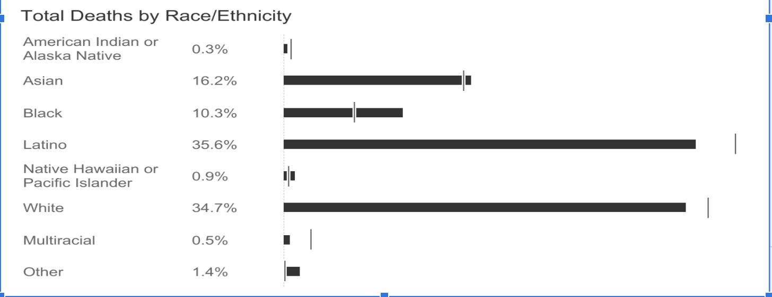
Notes:
死亡种族比率

Slide 28
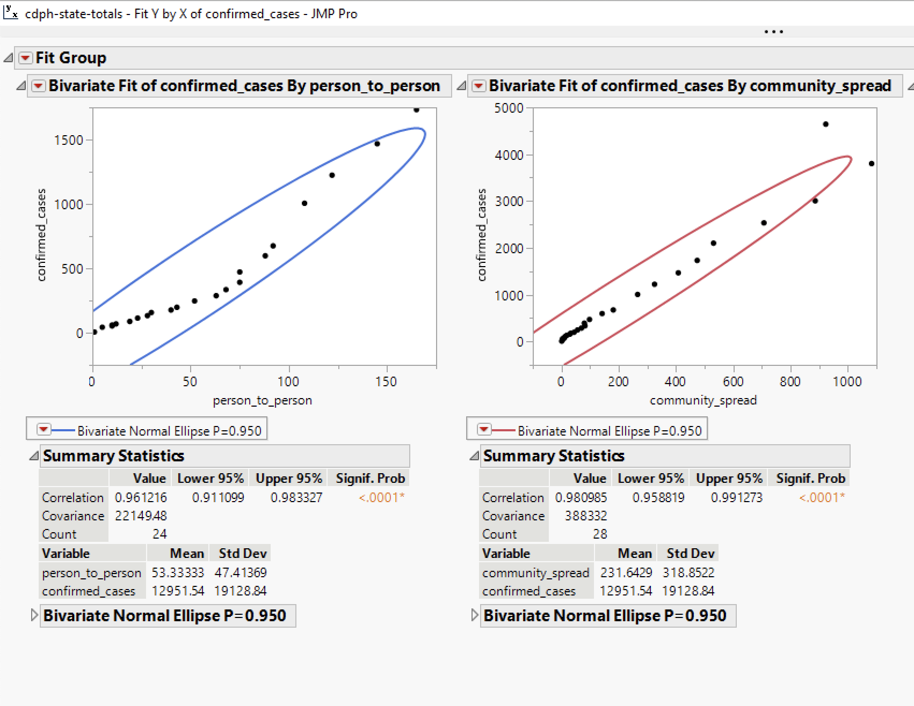

Slide 29
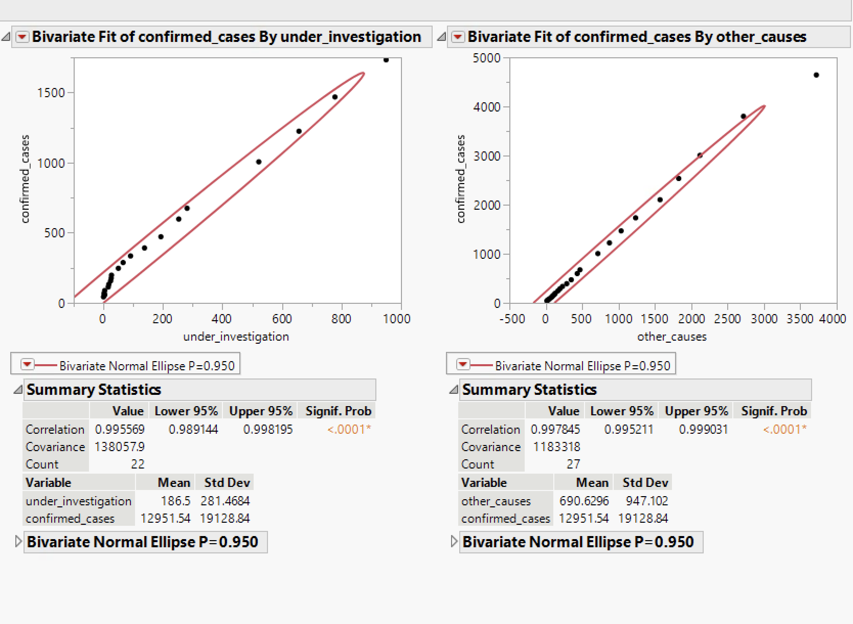

Slide 30
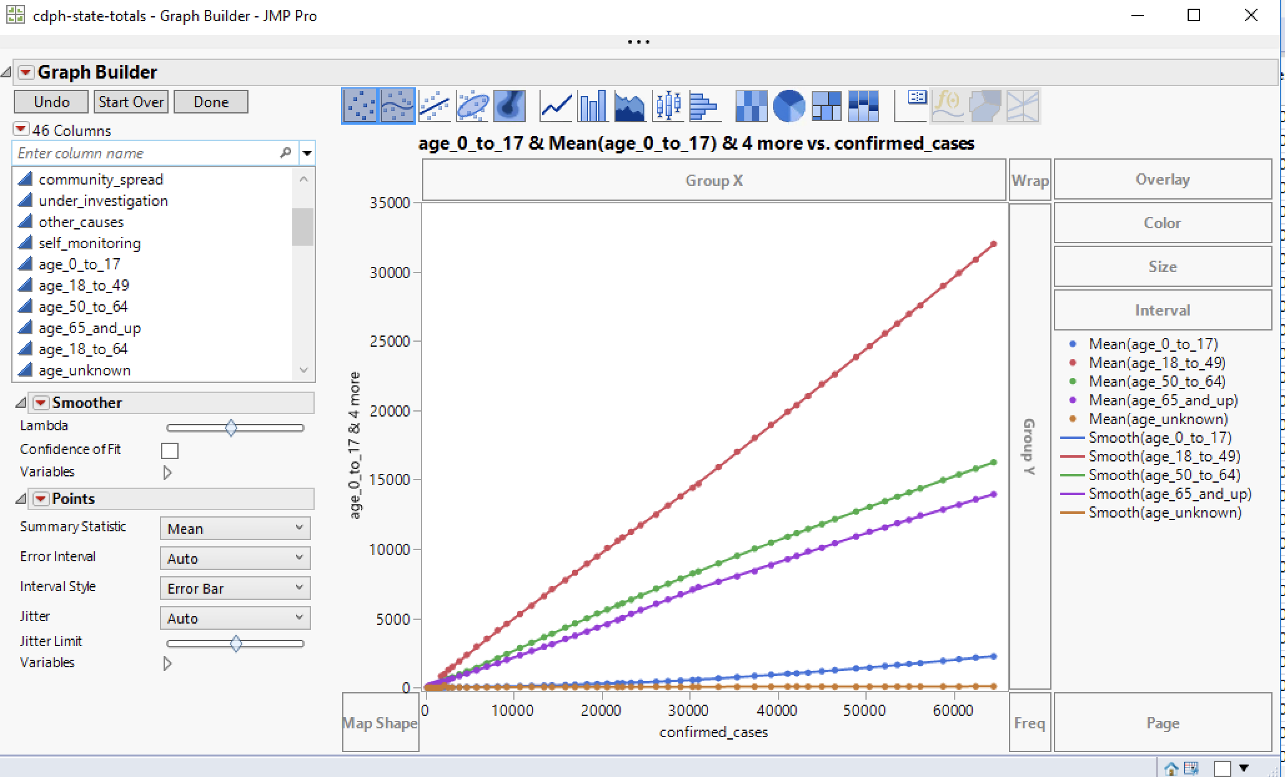

Slide 31
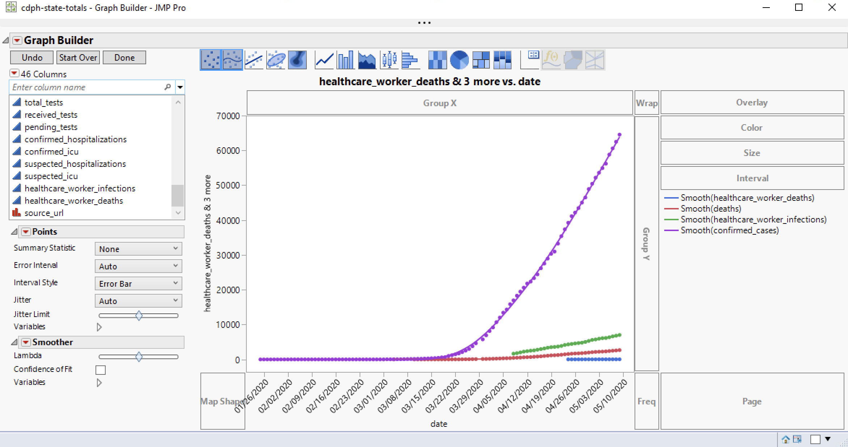

Slide 32
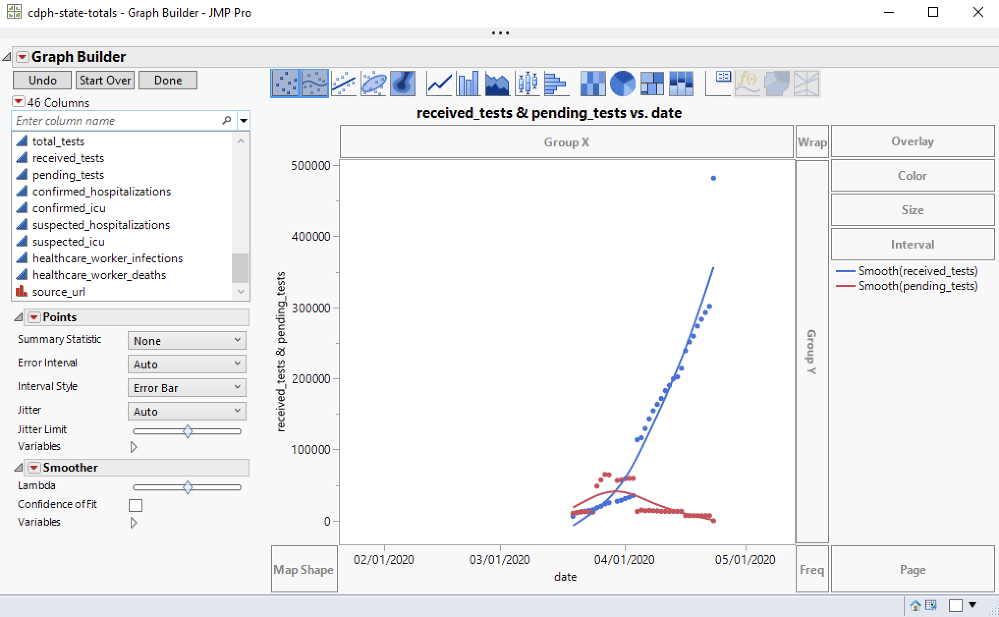

Slide 33
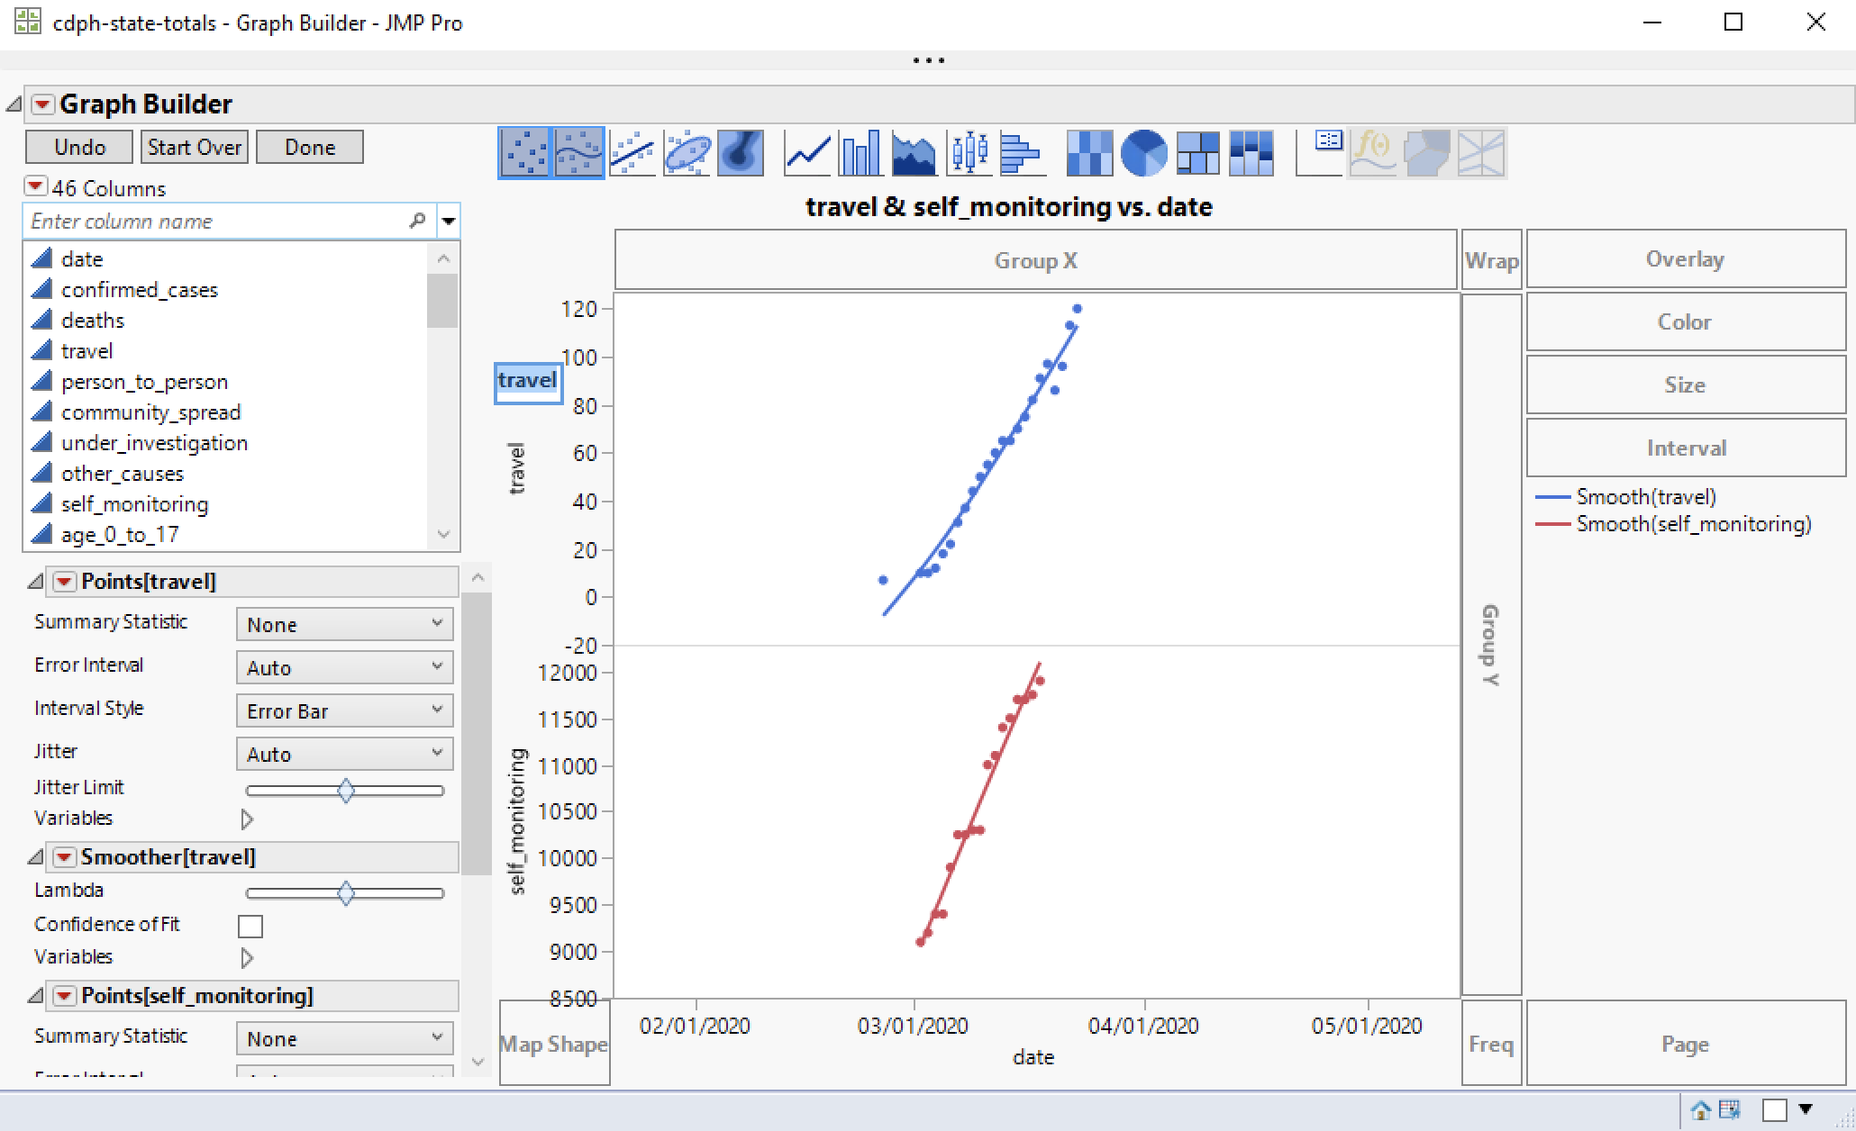

Slide 34
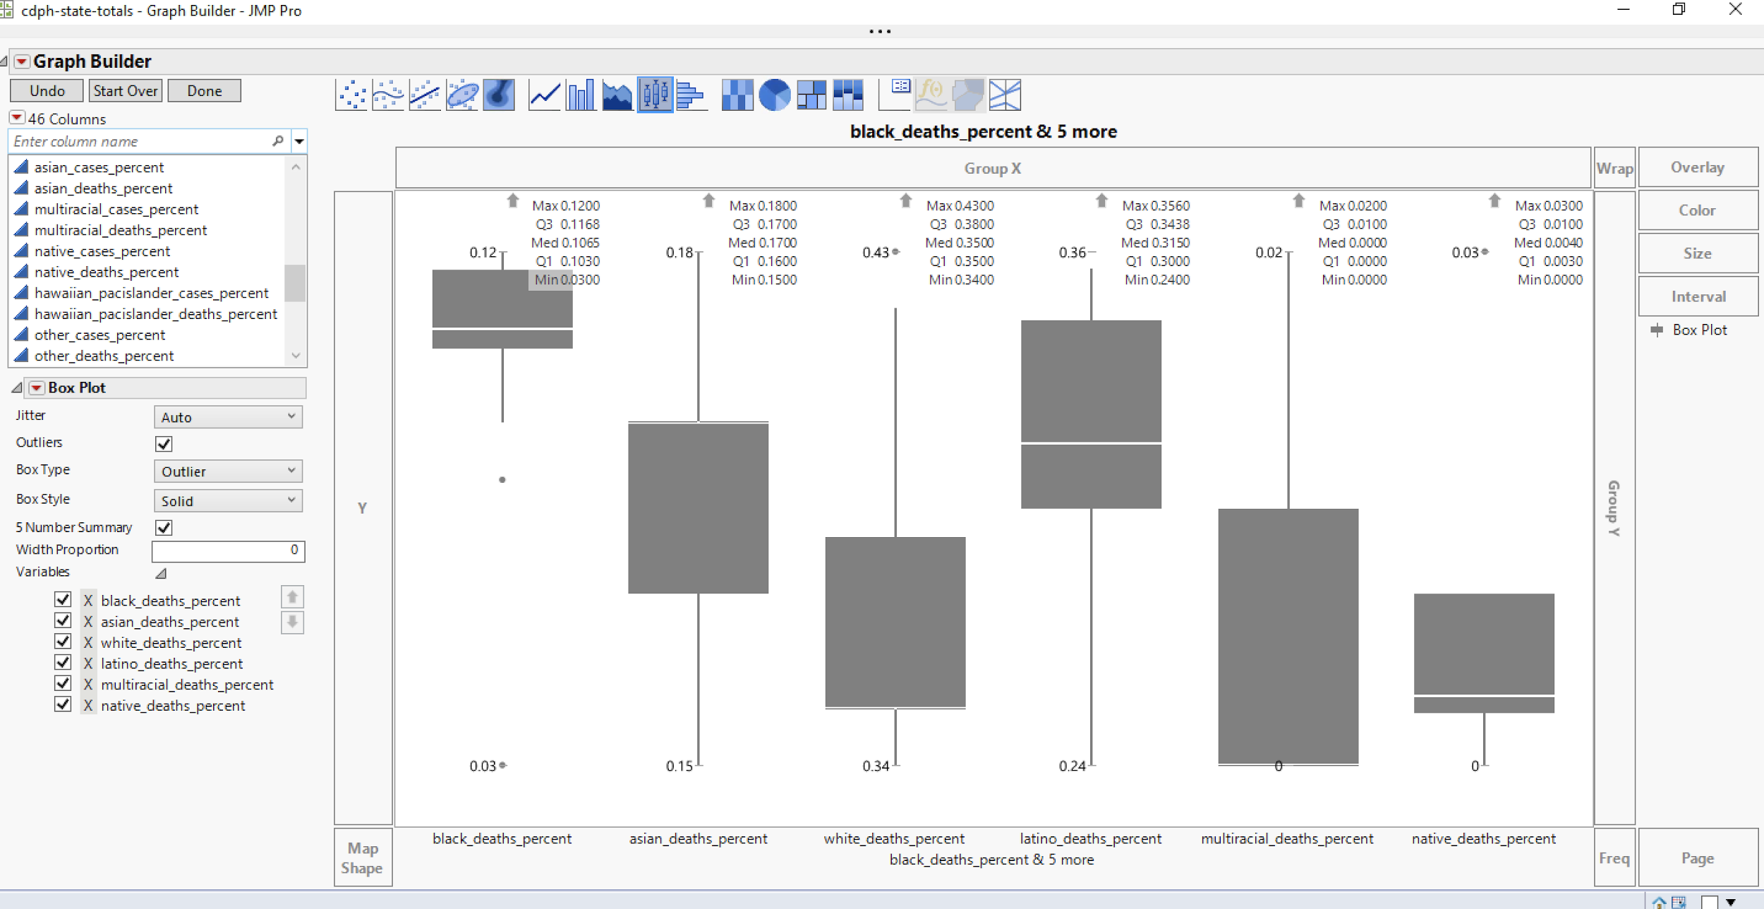

Slide 35
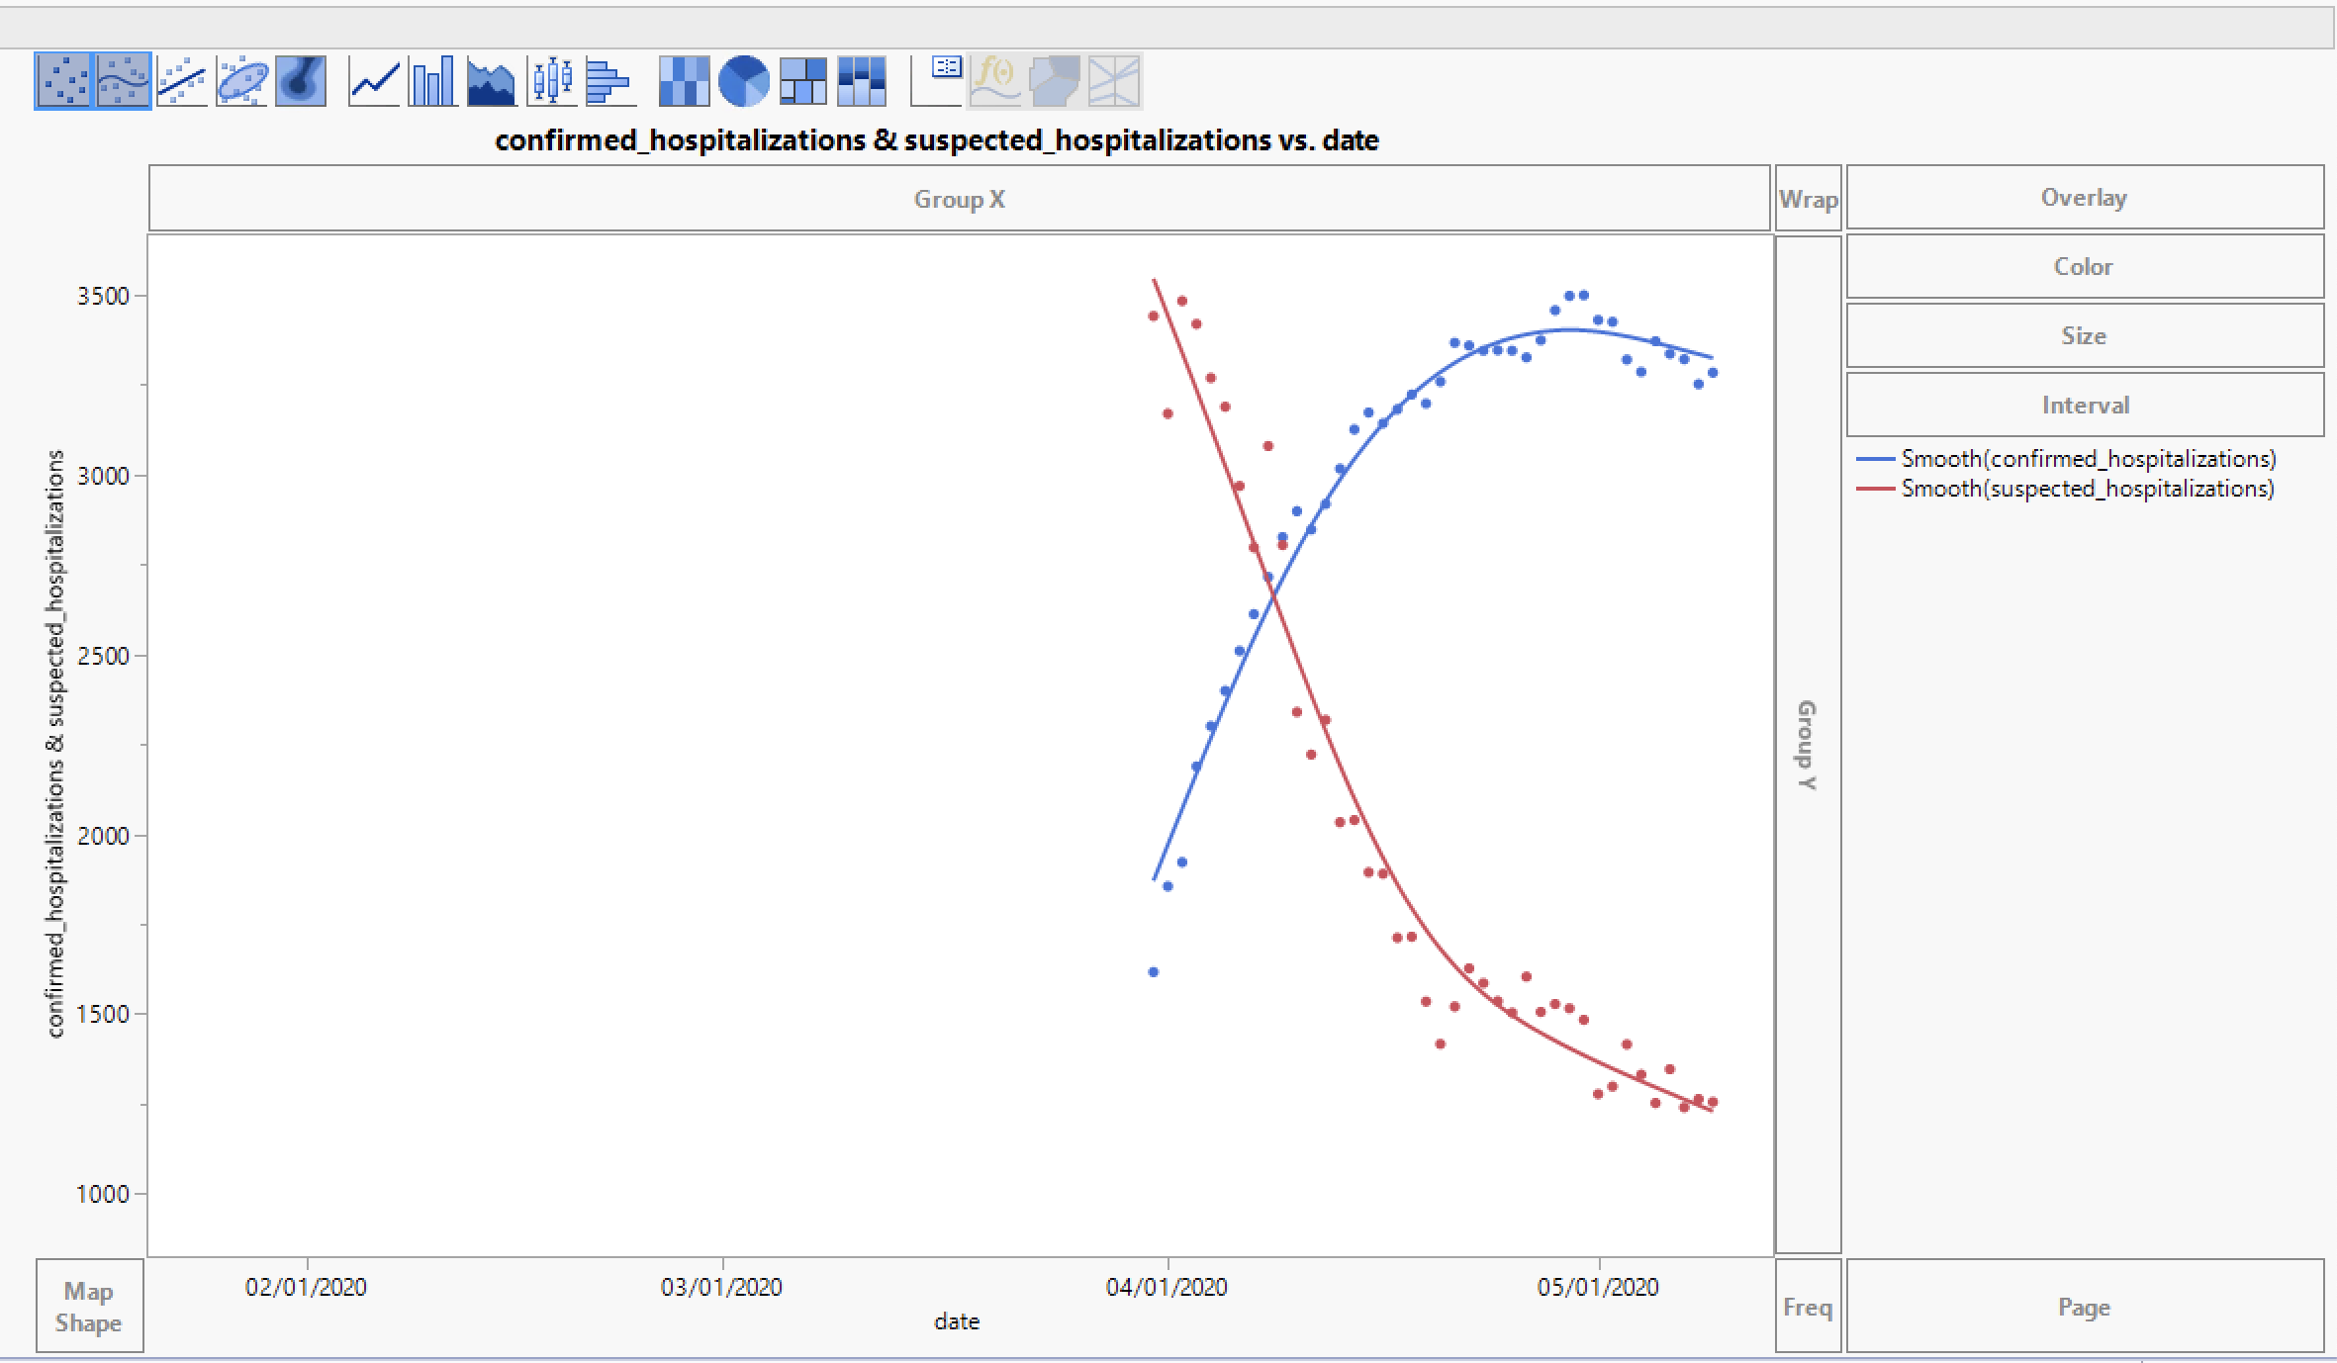

Slide 36
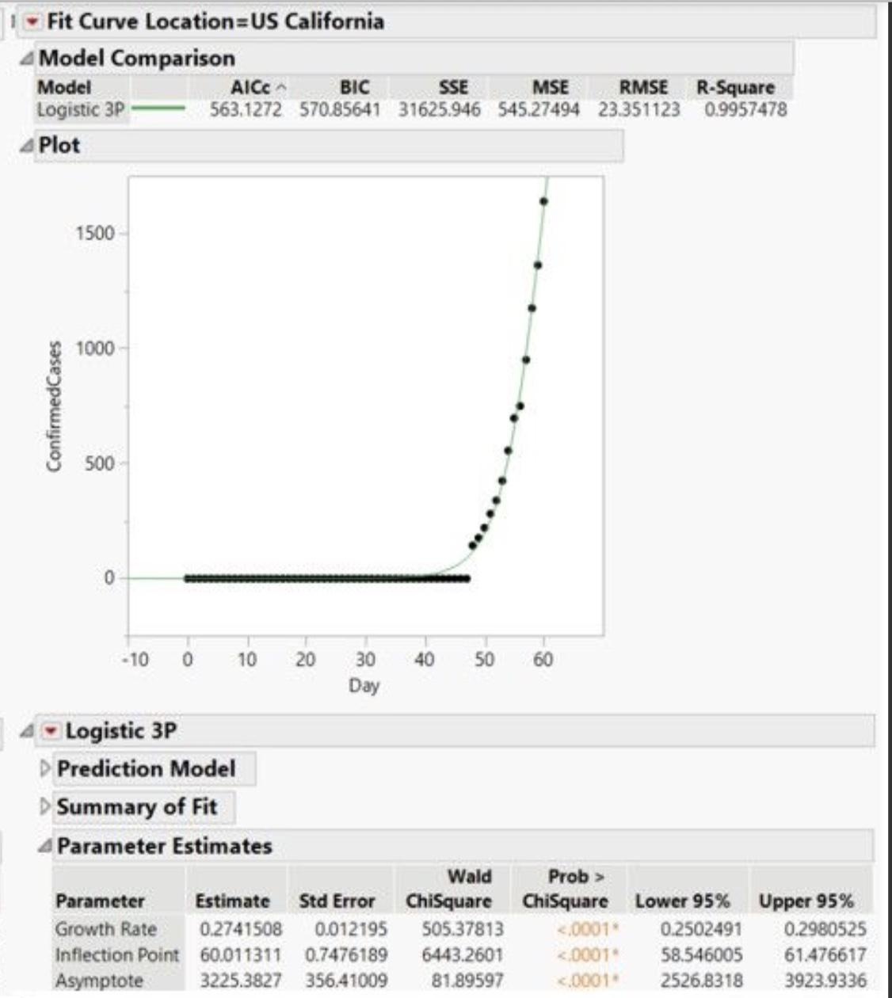
Notes:
\

Slide 37
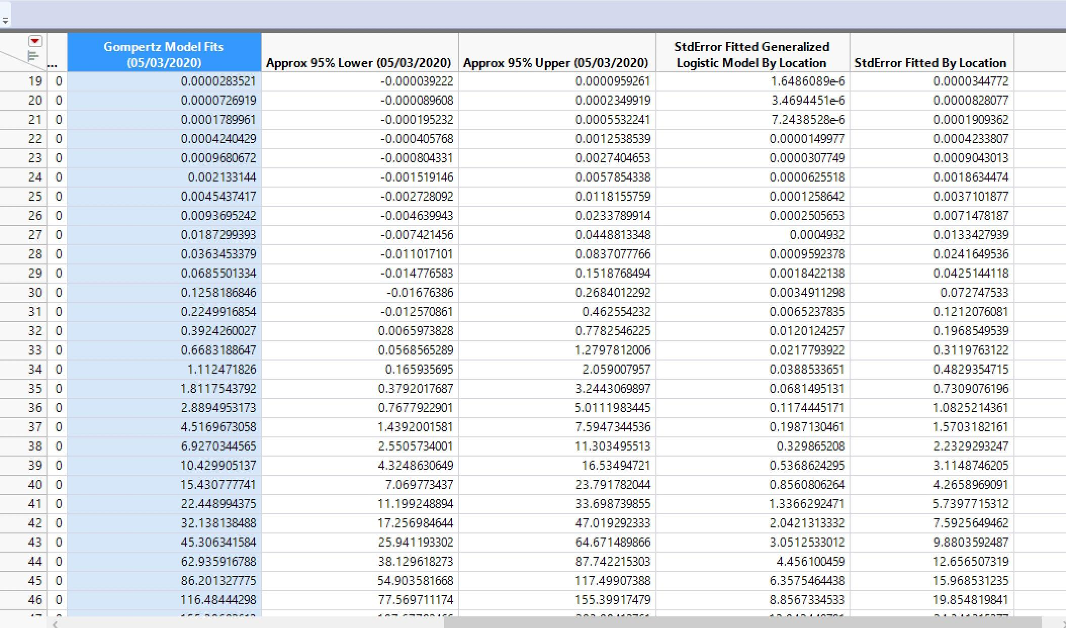

Slide 38
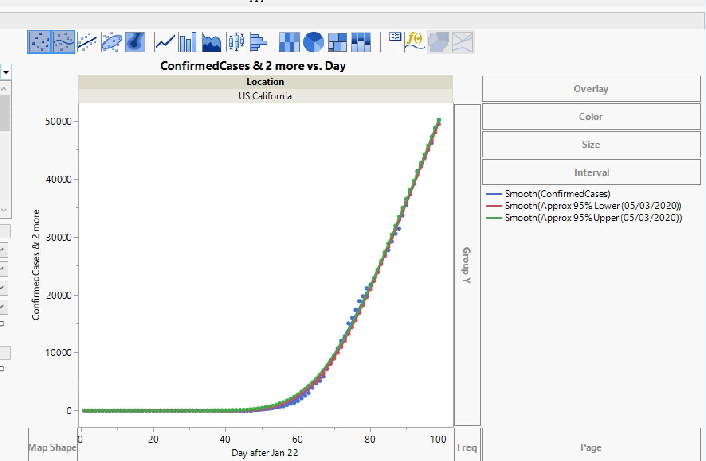
Notes:
加州确诊人数趋势图

Slide 39
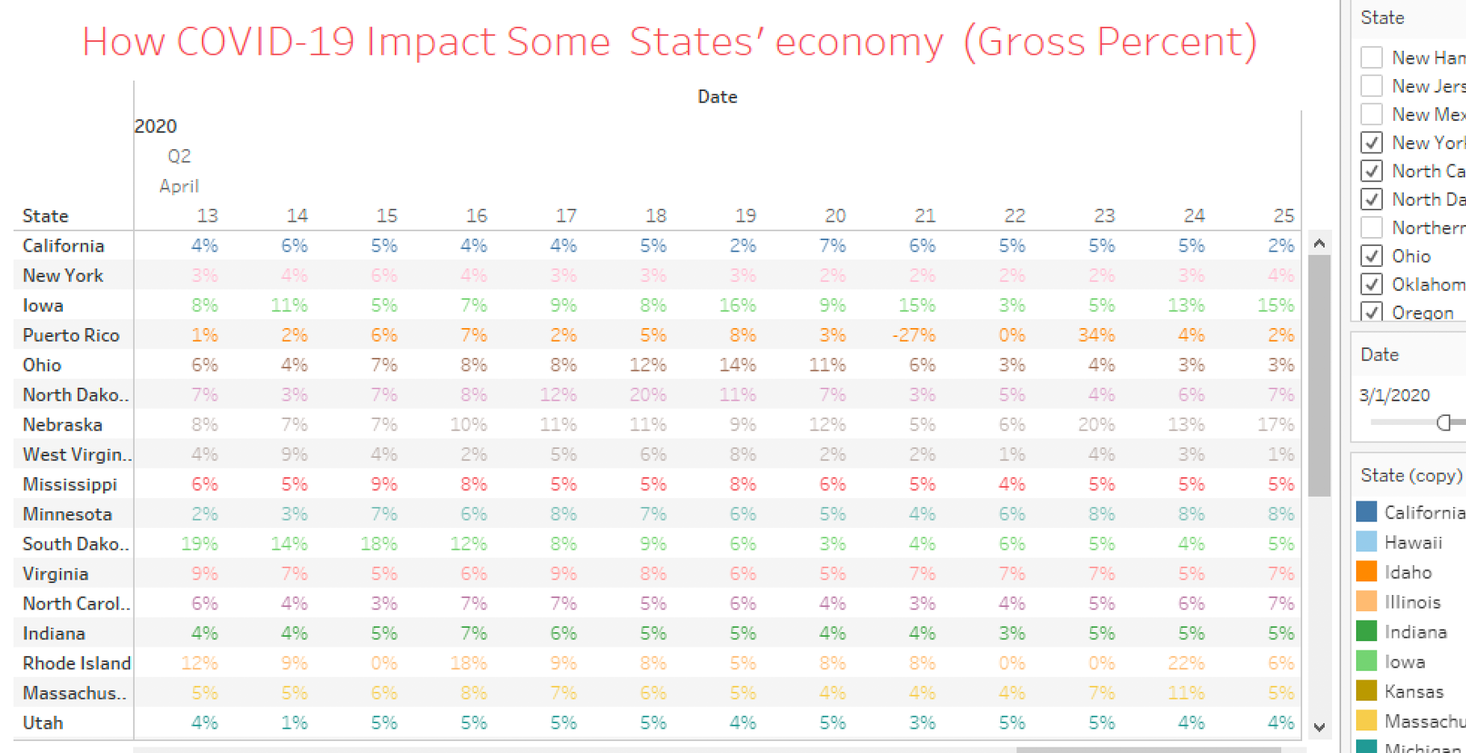
Notes:
各州收入率

Slide 40
Data Reference
https://github.com/CSSEGISandData/COVID-19/tree/master/csse_covid_19_data
https://ourworldindata.org/coronavirus-source-data
https://community.jmp.com/t5/JMP-Blog/Lessons-learned-in-modeling-Covid-19-Pt-1/ba-p/255927

